Slide 1
The Slicers
The Slicers

Slide 2
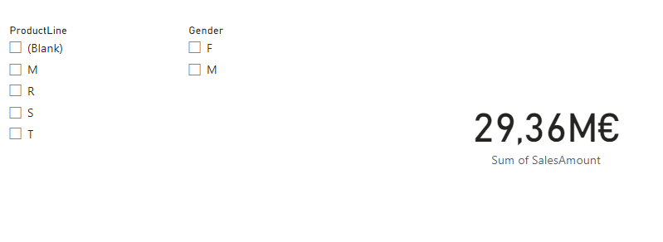
The Slicers
Add two Slicer visualizations to the scene and one Card Visual
Configure the first Slicer to show ProductLine from the DimProduct Table
Configure the second Slicer to show Gender from the DimCustomer Table
Configure the Card Visual to shows Sales Amount from FactInternetSales table
Try to select different options from the slicers and observe the impact on the Card visual

Slide 3
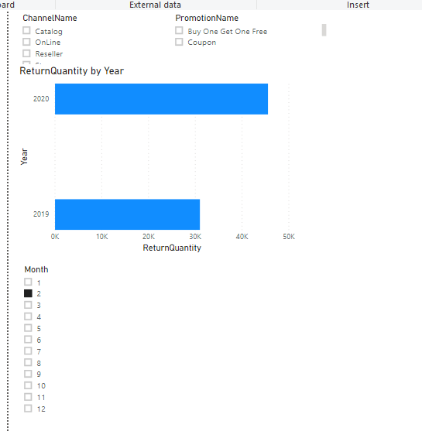
The Slicers
Note that the last field is numeric.

Slide 4
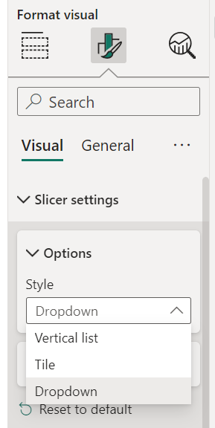
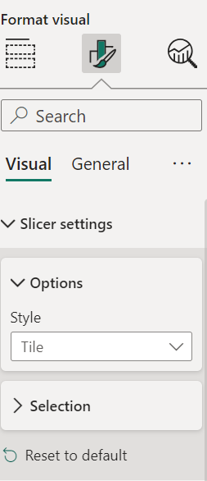
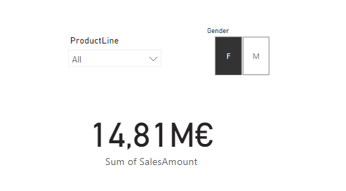
The Slicers
Change the visual behaviors of the two Slicers to Dropdown and Tile respectively for ProductLine and Gender respectively using the Format section, then Style
1
1
2
2
3
3

Slide 5
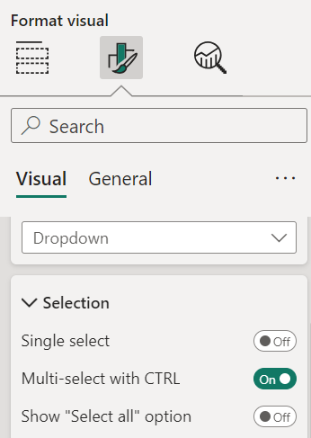
The Slicers
Now Try to change the selection behaviour always from Format section then Selection

Slide 6
Thank you
Thank you

